Slide 1

RABINDRA NATH TAGORE ADVANCED RESEARCH CENTRE
POST GRADUATE DEPARTMENT OF BENGALI
LADY BRABOURNE COLLEGE

Slide 2

The Department of Bengali, Lady Brabourne College has been dedicated and working on the process of intellectual empowerment of Undergraduate as well as Post Graduate students and not just limiting to acquirement of knowledge in any restricted form but to perpetuate this knowledge into the society as an embodiment of knowledge stream. Rabindranath Tagore Advanced Research Centre approved by the University of Calcutta conceptualizes these views.

Slide 3
Since its inception on 14th August, 2014 (inaugurated by Late Tushar Kanjilal, Founder of Tagore rural development society), the focal point of this centre is to work on the thrust area of “KNOW THY REGION’’.
The Centre can now boast of a great collection of different types of folk songs, drama, literature and art.
It also has a great collection of paintings of famous Bengali painters.
The Centre has digitized SANI BARER CHITHI, DASI and BANGADARSHAN, the three famous Bengali Magazine Edited by Bankim Chandra Chattopadhyay and Sajani Kanta Das. This project was funded by the Higher Education Department, Govt. of West Bengal in the year 2016-17.

Slide 4
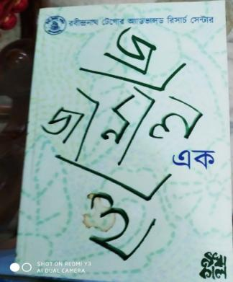
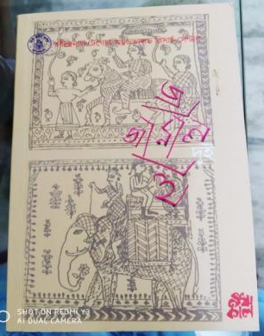
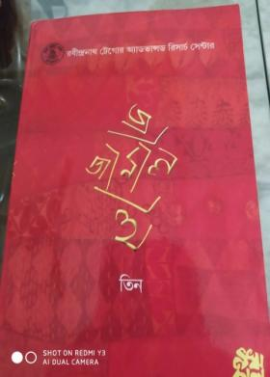
PUBLICATION OF A PEER-REVIEWED JOURNAL
The Centre has published a peer-reviewed Journal since 2017 funded by Department of Higher Education, Govt. of West Bengal.
1st volume 2nd volume 3rd volume

Slide 5
The Centre has organized the following lectures, seminars and workshops:
1 | Date: | 11.11.2014
 | Programme: | Documentary film show on Paintings of Rabindranath Tagore
 | Resource Person: | Sri Sanat Mahato Film Director
2 | Date: | 7.02.2015
 | Programme: | Lecture series-1: Bangla banan bidhi O banan samosya
 | Resource Person: | Prof. Pabitra Sarkar Eminent Educationist & Ex Vice-Chancellor Rabindra Bharati University

Slide 6
3 | Date: | 14.02.2015
 | Programme: | Lecture series-2: Bartaman somoye Rajnaitik O samajik khetre Rabindranather Prasongikota
 | Resource Person: | Sri Jayanta Ghosal Eminent Journalist
4 | Date: | 26.08.2015
 | Programme: | Ist Sri Jatish Chandra Datta Endowment Lecture - Rabindranath: Nazi birodhita O samakalin viswa
 | Resource Person: | Prof. Basab Chowdhury Vice Chancellor West Bengal State University

Slide 7
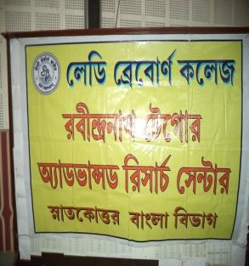
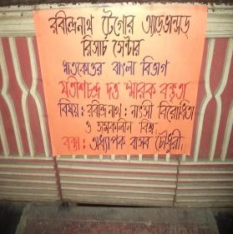
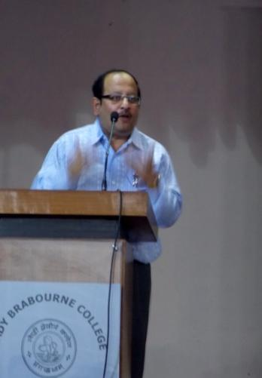
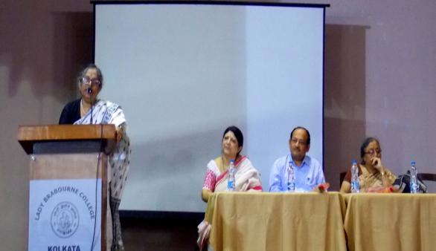
Prof. Basab Chowdhury, Vice Chancellor, West Bengal State University delivering his lecture on 26.08.2015
Prof. Gopa Dutta, Ex-Principal, Lady Brabourne College sharing her views at the inauguration

Slide 8
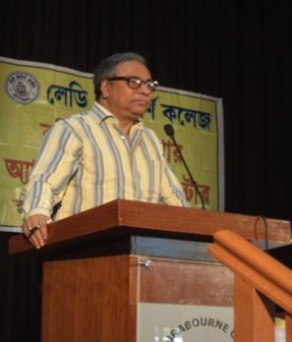
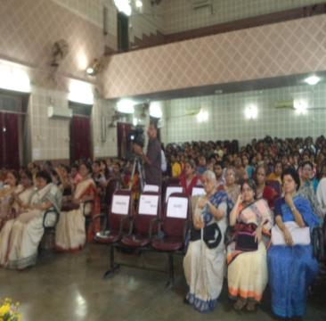
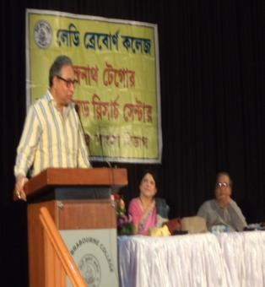
5 | Date: | 12.12.2015
 | Programme: | Lecture series-3: Bharat Sangskriti O Rabindranath
 | Resource Person: | Sri Jawhar Sircar Ex CEO, Prasar bharati
Sri Jawhar Sircar delivering his talk on 12.12.2015
The audience

Slide 9
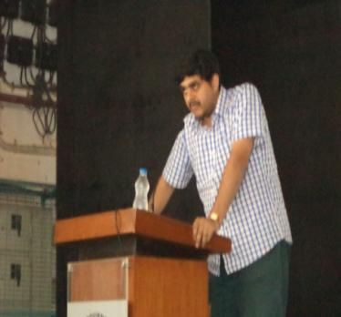
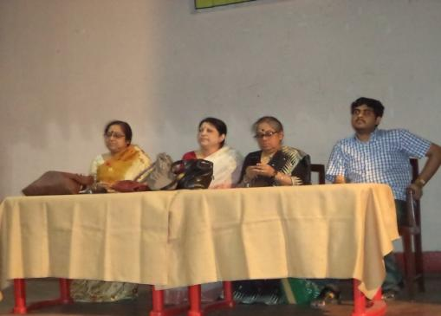
6 | Date: | 12.03.2016
 | Programme: | Ist Pran Krishna Bhattacharjee Endowment Lecture: Boi sompadona ki O keno
 | Resource Person: | Sri. Sanjib Mukhopadhyay Eminent Editor
Sri. Sanjib Mukhopadhyay delivering his talk on 12.3.2016
The inaugural session

Slide 10
7 | Date: | 19.09.2016
 | Programme: | 2nd Sri Jatish Chandra Datta Endowment Lecture: Gramaphone recorder prothom porber mahila shilpi
 | Resource Person: | Prof. Amlan Dasgupta Retired Professor Department of English Jadavpur University & Director School of Culture & Text Jadavpur University

Slide 11
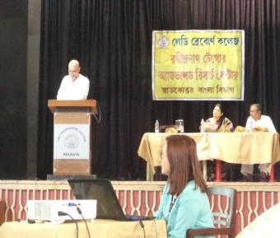
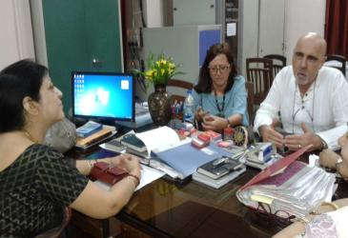
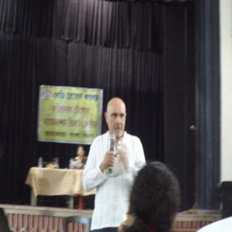
8 | Date: | 6.04.2017
 | Programme: | Lecture series-4: South- East Asian Studies in Canary Island
 | Resource Person: | Prof. Juan J. Cruz Professor of English Culture & Civilization, University of La Laguna, Canary Island , Spain
Prof. Juan J. Cruz with the Principal Prof. Siuli Sarkar
Prof. Juan J. Cruz delivering his lecture on 6.4.2017

Slide 12
9 | Date: | 21.08.2017
 | Programme: | 3rd Sri Jatish Chandra Datta Endowment Lecture on Depression
 | Resource Person: | Professor Pushpa Mishra President, West Bengal Psycho Analytical Society
10 | Date: | 24.09.2018
 | Programme: | 2nd PranKrishna Bhattacharjee Endowment Lecture - Natok: Monche O Jibone
 | Resource Person: | Sri Debsankar Haldar Eminent Theatre Personality

Slide 13
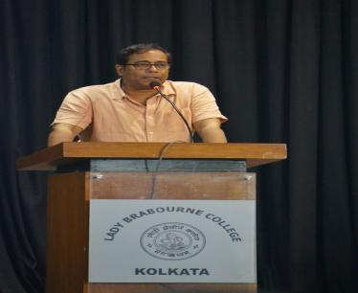
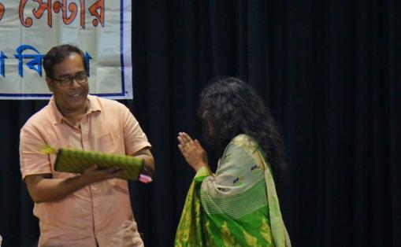
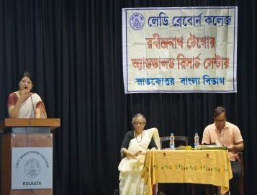
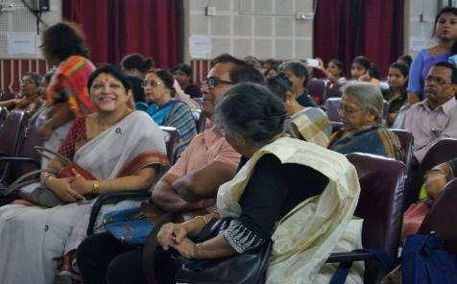
Sri Debsankar Haldar delivering his lecture on 24.9.2018
Sri Debsankar Haldar being felicitated
The Principal Prof. Siuli Sarkar inaugurating the lecture
Sri Debsankar Haldar sharing a light moment

Slide 14
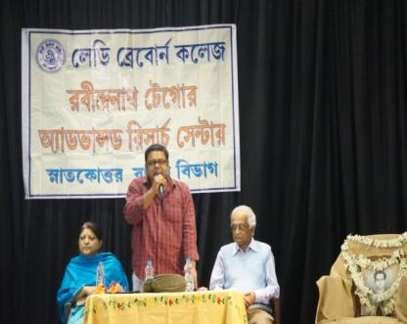
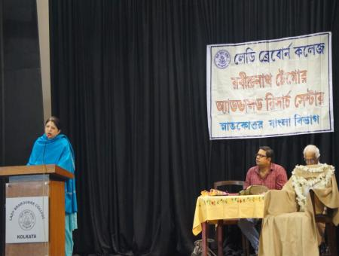
11 | Date: | 7.12.2018
 | Programme: | 4th Sri Jatish Chandra Datta Endowment Lecture: Bangali Jibone Mach O Rabindranath
 | Resource Person: | Sri Rajatendra Mukhopadhyay Eminent Journalist, Writer & Poet
Sri Rajatendra Mukhopadhyay delivering his lecture
Principal Pro. Siuli Sarkar delivering her inaugural speech

Slide 15
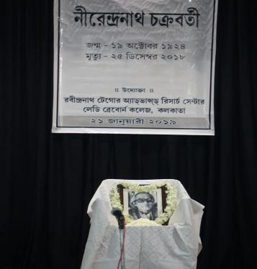
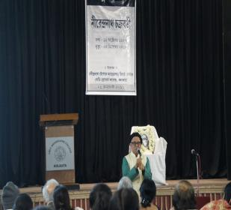
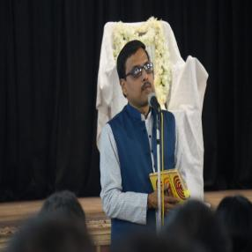
12 | Date: | 21.01.2019
 | Programme: | Sradhha Smaran of famous poet Sri Nirendranath Chakrabarty
 | Resource Persons: | Famous poet Sri Subodh Sarkar Prof. Angshuman Kar Shyamal Kanti Das Pankaj Saha Prof. Pabitra Sarkar Family members of Late Poet
Prof. Pabitra Sarkar, Ex Vice Chancellor of Rabindra Bharati University
Prof. Angshuman Kar,
Poet & Editor of Krittibad

Slide 16
13 | Date: | 12.3.2019 to 18.3.2019
 | Programme: | 7 days Workshop on “Meyeder Path Chala: Unish o Bish Sataker Bangla” in collaboration with West Bengal State University & financially supported by Govt. of West Bengal
 | Resource Person: | Renowned Scholars, Musicians, Poet, Journalist, Film Critique, Household workers
 | Participants | 70 College teachers, Research Scholars and Post Graduate students from all over West Bengal

Slide 17
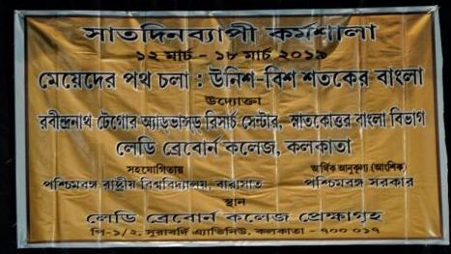
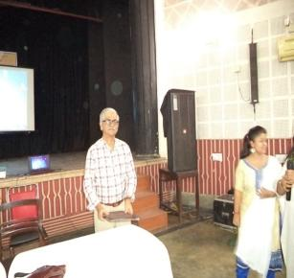
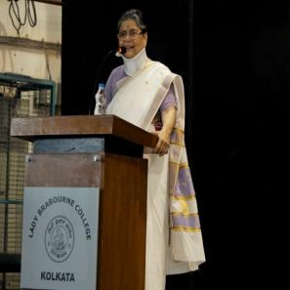
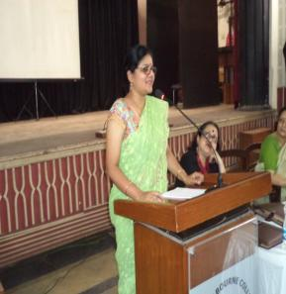
SOME GLIMPSES OF THE WORKSHOP
Sanjay Mukhopadhyay
Film critique
Malini Bhattacharjee, Eminent Educationist& Ex-Chairperson of State Women’s Commission
Swati Bhattacharjee, Eminent Journalist of Ananda Bazar Patrika

Slide 18
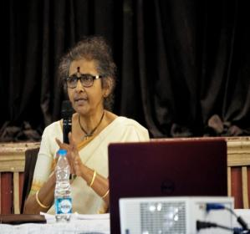
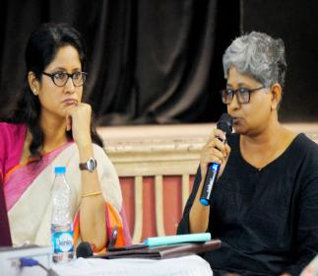
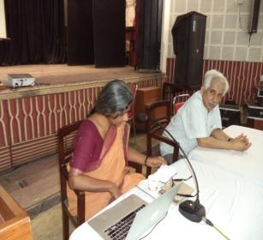
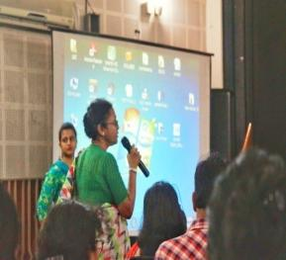
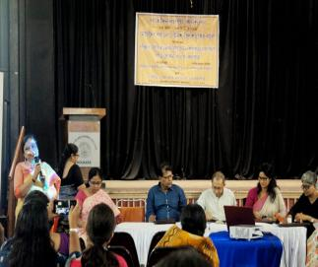
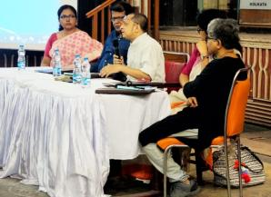
SOME GLIMPSES OF THE WORKSHOP
Rushati Sen, Eminent Educationist
Somoya Akhtar, Editor & Publisher of Raban Prakadhani & Sumita Samanta, Publisher Writa ptakashani
Mousumi Bhowmick, Singer & Activist & Amlan Dasgupta, eminent Educationist
Panel discussion & Interactive session

Slide 19
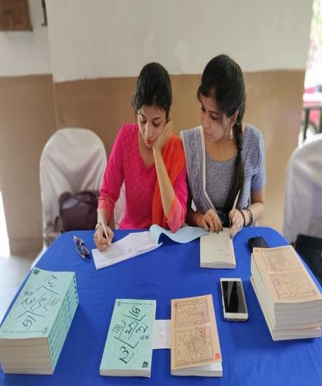
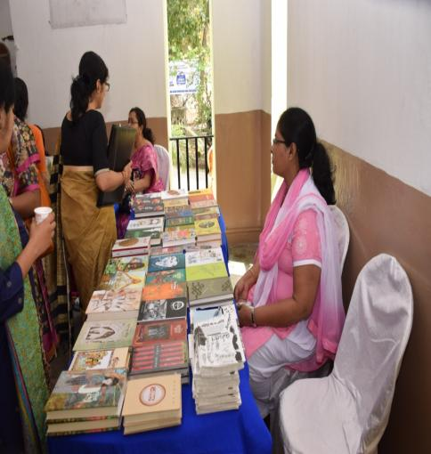
SOME GLIMPSES OF THE WORKSHOP
The book stall and the desk for sale of Journals

Slide 20
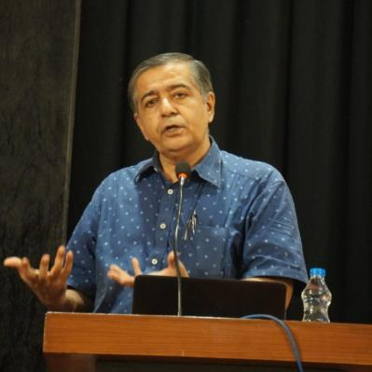
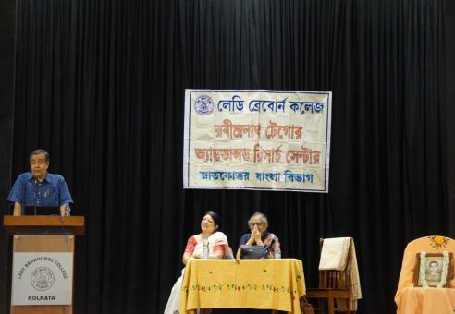
14 | Date: | 20.09.2019
 | Programme: | 5th Sri Jatish Chandra Datta Endowment Lecture: Kalpobigyan (Science fiction)
 | Resource Person: | Prof. Palash Baran Pal Eminent Physicist
Prof. Palash Baran Pal delivering his lecture

Slide 21
15. Two other Endowment Lectures in memory of Sri Jatish. Ch. Datta (Father of Prof. Gopa Datta, Former Principal, Lady Brabourne College) and Sri Prankrishna Bhattacharya (Grand father of Dr. Sampa Bhattacharjee one of our Alumni) were also organized.

